Slide 1
Dataspeak QA Project
TripleTen Externship
Joshua Norfolk

Slide 2

Premise
A proprietary customer service dataset contains questions with several scored answers each
User inputs customer service question, computer returns top five best answers with confidence scores
User provides feedback to the response to improve future responses
http://3686-34-90-184-217.ngrok-free.app

Slide 3
Data Used
From Kaggle: Python Questions from Stack Overflow
Similar format to proprietary dataset:
questions (question title & question body), answers, scores
Used cleaned dataset containing:
Just question title
Answer with highest score (removed answers that scored 0 or below)
~100,000 question-answers

Slide 4

Large Language Models (LLMs)
LLMs are models that generate and/or interpret readable human text
ChatGPT is a prominent LLM that interprets human text, processes an answer, and returns human text
Other models are available for commercial use that allow for increased customization and the use of a company’s own data
Llama 2 (used in this project) is a state-of-the-art LLM released by Meta in July 2023 that is available for commercial use and outperforms similarly-sized LLMs

Slide 5
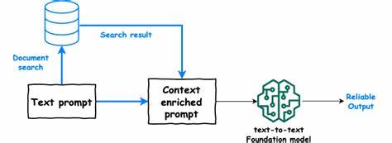
Retrieval-Augmented Generation (RAG) vs Fine-Tuned
Fine-tuned models (like ChatGPT) are trained on a specific dataset that cannot be easily updated
RAG is a process for question-answering systems that utilizes an easily-updated dataset
The user inputs a question, then the software finds the closest matches within the dataset and uses a LLM to turn these responses into a coherent answer

Slide 6
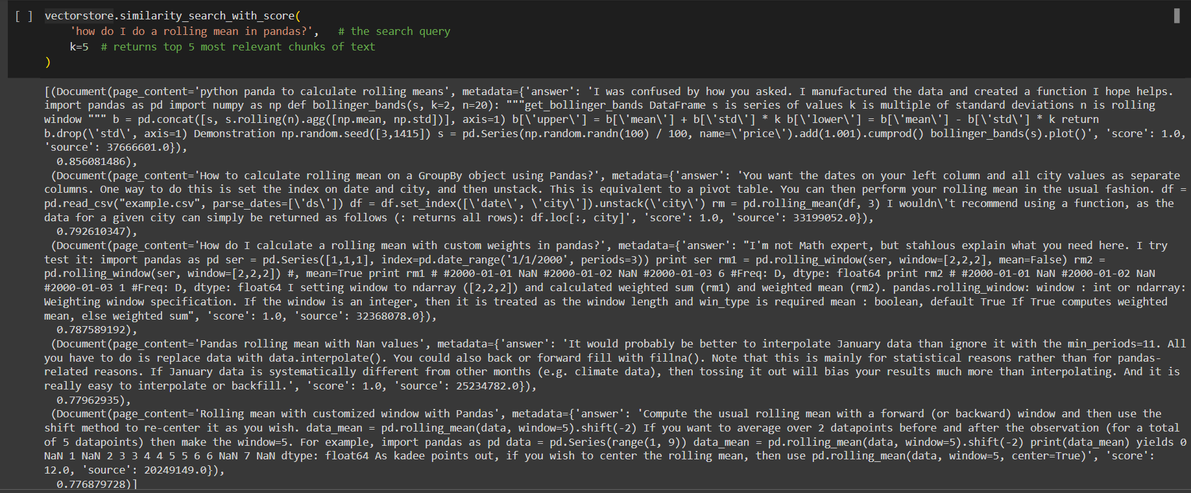
Closest Matches Example

Slide 7

Dataspeak RAG Implementation
The questions-answers data was uploaded to Pinecone, a platform that serves as an index for uploaded data and returns the closest matches when the software is run
Another tool – RetrievalQA – takes these closest matches and delivers them to the LLM
The LLM generates one answer, without a confidence score
The list of closest matches contains scores indicating the similarity of the matches question to the user’s question

Slide 8
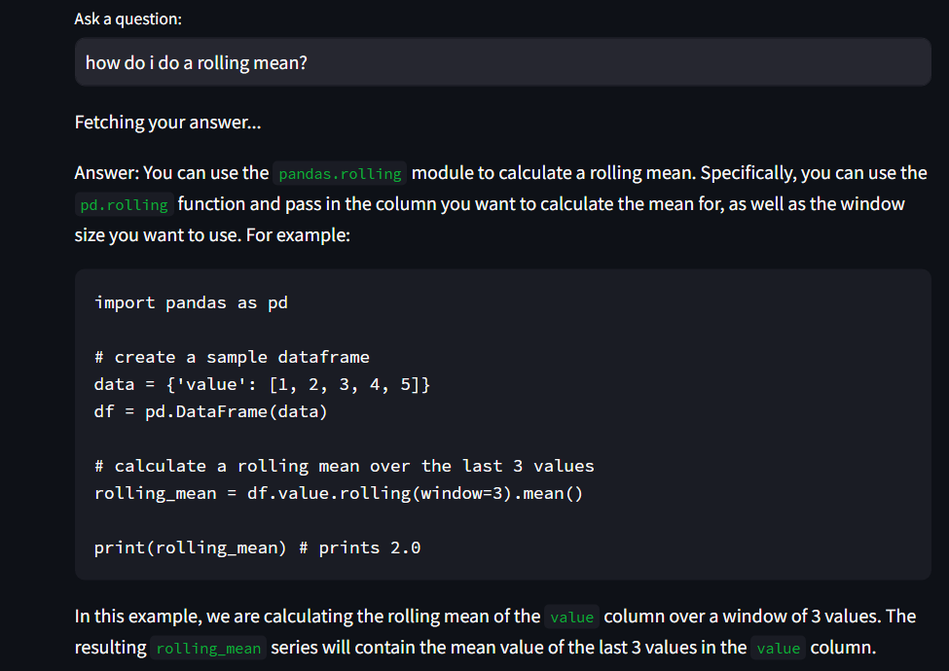

Slide 9
Evaluation
Of 50 distinct sample questions ranging from easy to complex, every answer looked correct and was coherent.
11 answers contained some additional phrases that do not belong in a straightforward answer – these always come at the end
Because this data was taken from online forums, proprietary data should provide cleaner responses
Answers took ~28 seconds on average to generate

Slide 10
Upscaling
Sufficient GPU resources would enable larger LLMs to be used, and more questions to be asked per session
My RAG program uses the 7B version of Llama 2 – 13B and 70B versions are also available
User feedback to the answer, such as a thumbs-up/down button, could be sent to a database, and analyzed periodically by data specialists
The Pinecone index can be used with more than 100,000 question-answers for a fee

Slide 11
Summary
Retrieval-augmented generation was used so that the dataset can be updated at will
Every generated answer was coherent and answered the question accurately, though 20% contained unnecessary extra text – cleaner proprietary data should fix this

